Slide 1
Elevator MQTT
Manuel Ahrer, Michael Hinterberger, Hannes Peball

Slide 2
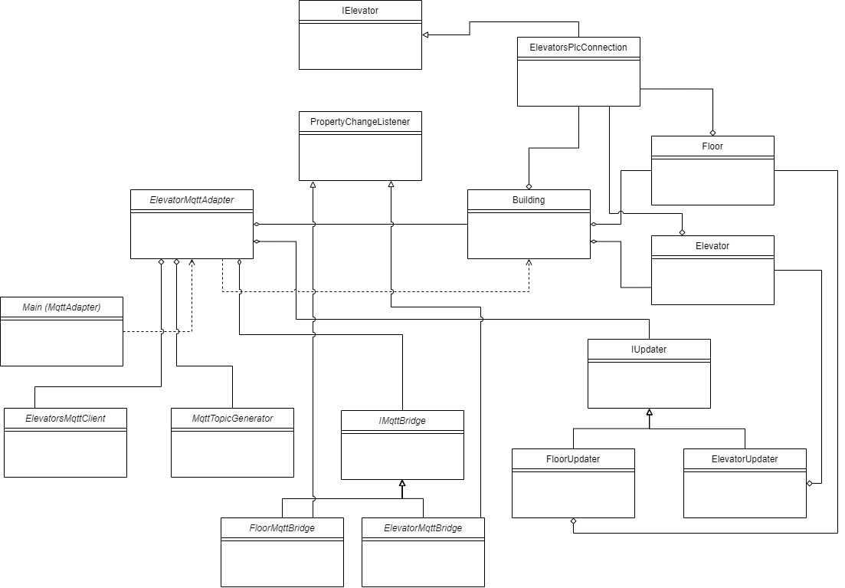
MqttAdapter Architecture

Slide 3
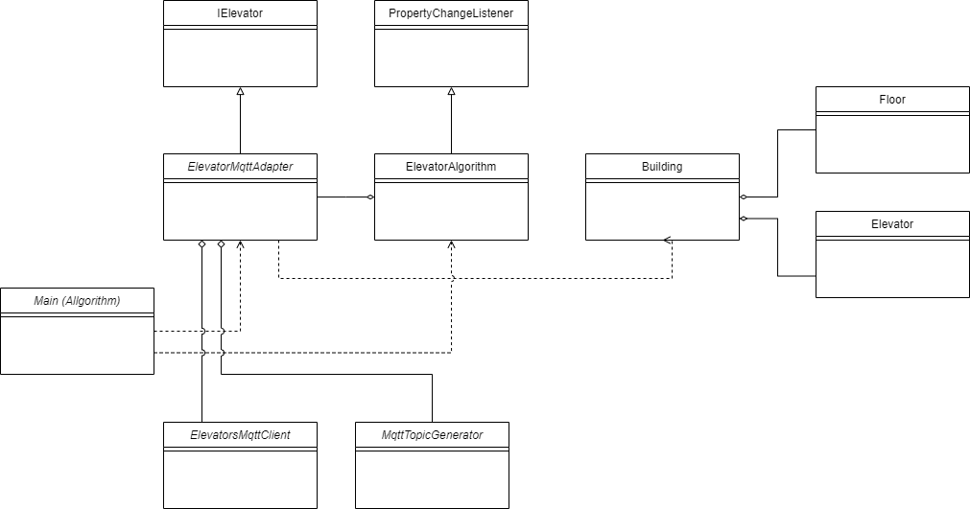
ElevatorAlgorithm Architecture

Slide 4
Build & Test Automation
GitHub Actions
Push or pull requests on master
Executes unit tests and mutation tests
Long execution time because of docker containers
On new release: Start build without tests or sonar for release artifacts
SonarCloud Analysis (Coverage, Static code analysis)
Required coverage for overall code: 60%
Required coverage for new code: 80%

Slide 5
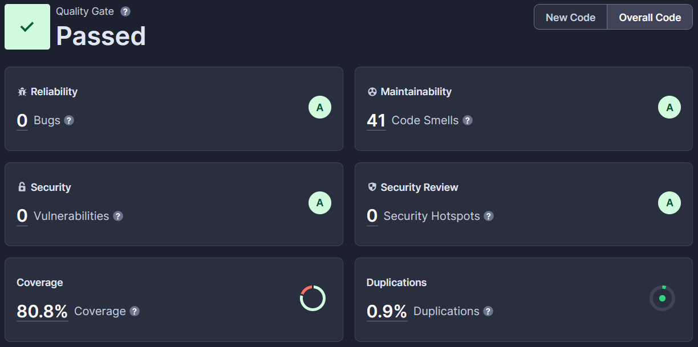
Static Analysis (SonarCloud)

Slide 6
Code Reviews
Merging on master branch via pull request
Review on pull request
Pair programming sessions

Slide 7
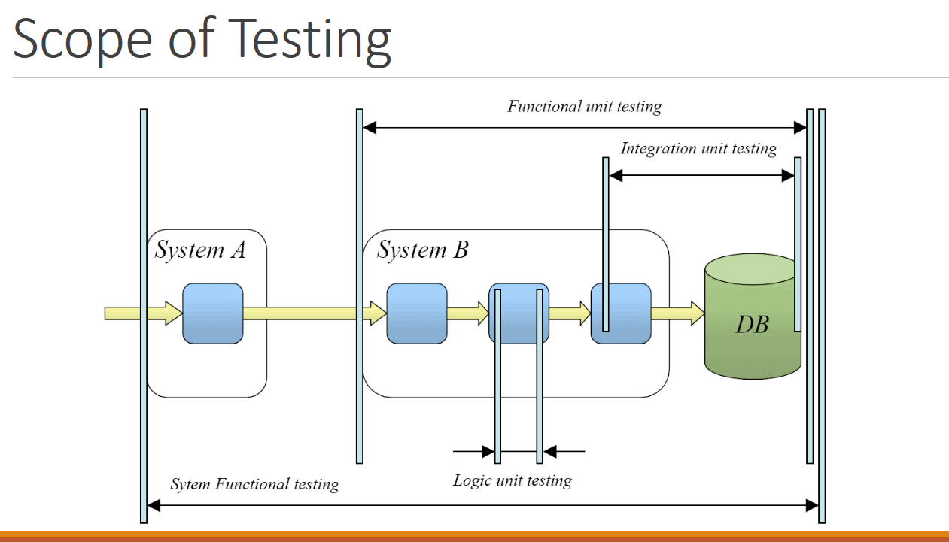
Testing techniques
Unit tests (white box testing)
Integration tests (with RMI, MQTT broker)
Functional unit tests (MQTTadapter, algorithm)
Full system test (black box)
JUnit for unit tests
Mockito for mocking dependencies
Mutation tests with pittest for test quality
HiveMQ Docker Container as MQTT Broker

Slide 8
Encountered Problems
Mockito mocks in Multithreaded Context -> sporadic test failures
Tests creating and removing RMI registry entries
HiveMQ MQTT Client uses many receive threads internally -> received messages from many different threads
MQTT Client hangs if receiver thread is used for publishing
Long duration of unit tests using MQTT Broker docker container
Very long duration of mutation tests

Slide 9
Lessons Learned
Unit tests identifies problems at an early stage
qualitative unit tests can safe time later
Testing becomes a lot harder if you don’t consider it in the design phase
Testability and SOLID can lead to a complicated architecture which requires lots of (unit) tests to fully cover
100% coverage (mutation) does not guarantee success of integration/system test
Think about what the test cases should cover before writing them

